Slide 1
Understanding Data
Machine Learning– BCS602

Slide 2
Prerequisite- Data
All facts are data.
In computer systems, bits encode facts present in numbers, text, images, audio, and video.
Data can be directly human interpretable (such as numbers or texts) or diffused data such as images or video that can be interpreted only by a computer.
Today, business organizations are accumulating vast and growing amounts of data of the order of gigabytes, tera bytes, exabytes. A byte is 8 bits.
A bit is either 0 or 1. A kilo byte (KB) is 1024 bytes, one mega byte (MB) is approximately 1000 KB, one giga byte is approximately 1,000,000 KB, 1000 giga bytes is one tera byte and 1000000 tera bytes is one Exa byte.

Slide 3
BI Variate and Multi Variate Data
Bivariate Data: Bivariate data involves two variables and examines the relationship between them.
Ex: Study Hours vs. Exam Scores, Height vs. Weight
Multivariate Data: Multivariate data involves three or more variables, analyzing their relationships and dependencies.
Multivariate data analysis involves multiple variables, requiring a solid understanding of mathematics.
EX: Customer Analysis, Weather Forecasting
Visualization: Multivariate scatter plots, heatmaps, principal component analysis (PCA), machine learning model
Notes:
EX: Customer Analysis, : Studying age, income, and spending habits to understand buying behavior.
Weather Forecasting: Considering temperature, humidity, and wind speed to predict weather

Slide 4
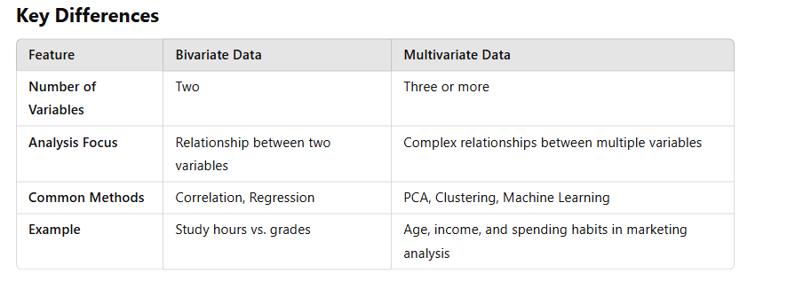
Bivariate data and Multivariate data

Slide 5
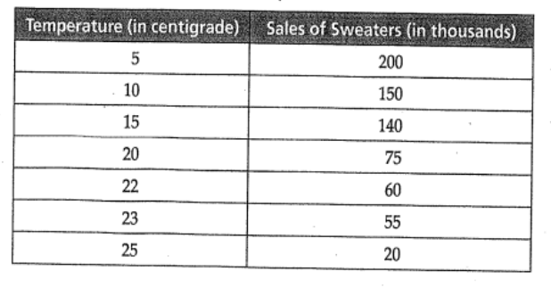
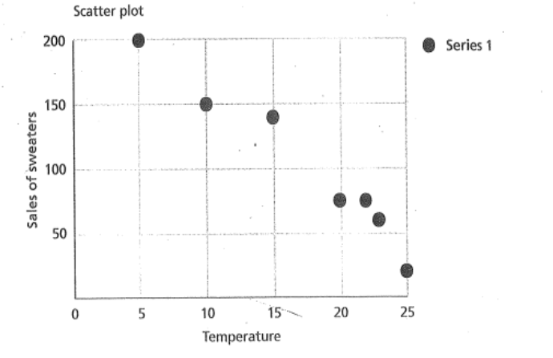
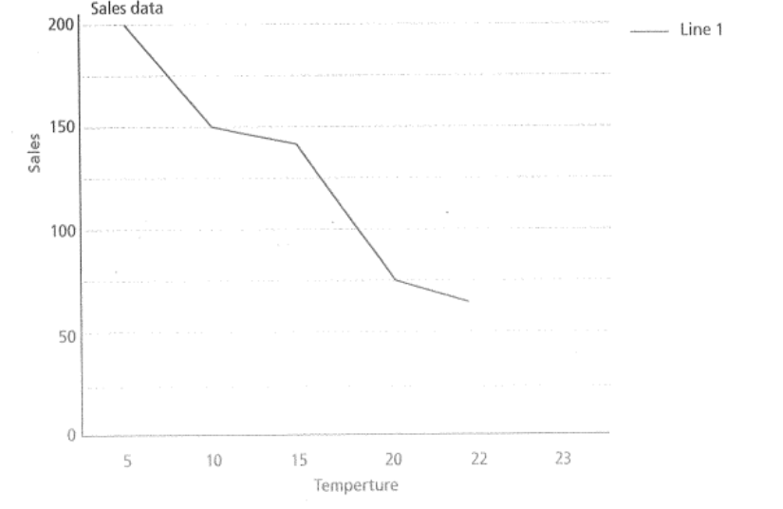
Example of Bivariate variables…contd
Fig 1 (a) shows the data of temperature in a shop and sales of sweaters.
Bivariate analysis is used to show the relationship between variables. Used to analyze correlations, trends, and dependencies between two variables.
Visualization: Scatter plots, correlation coefficients, regression analysis
Fig 1 (b) shows a scatter plot indicates the strength, shape and the presence of outliers and fig. 1(c) is a line plot.

Slide 6
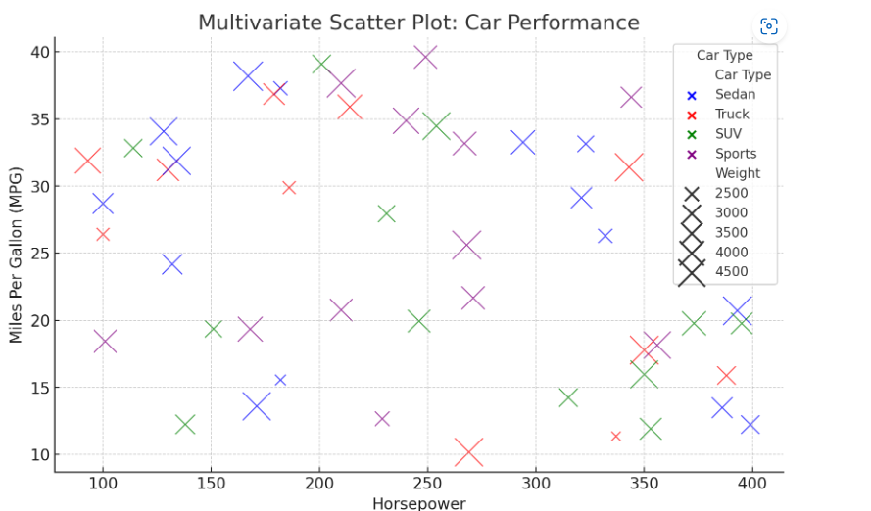
BI Variate and Multi Variate Data
Multivariate scatter plots
Example: Car Performance Analysis
We have dataset of cars with the following attributes:
Horsepower (X-axis)
Miles per gallon (MPG) (Y-axis)
Car weight (Marker size)
Car type (Marker color)
A multivariate scatter plot can show how horsepower affects fuel efficiency while also visualizing weight and car type using different sizes and colors.
Notes:
EX: Customer Analysis, : Studying age, income, and spending habits to understand buying behavior.
Weather Forecasting: Considering temperature, humidity, and wind speed to predict weather

Slide 7
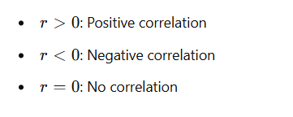

Types of Bivariate Statistics
Definition: Bivariate statistics involves the analysis of two variables to determine their relationship.
Types of Bivariate Analysis:
Correlation Analysis : Measures the strength and direction of the relationship between two variables.
Pearson's correlation coefficient is commonly used
:

Slide 8


Regression Analysis
  Simple Linear Regression : models the relationship between two variables as
  Chi Square Test (For Categorical Data) : Measures the association between two categorical variables.
  T-tests (Comparing Two Groups): Determines if two groups have significantly different means.
where is the slope and is the intercept.

Slide 9
Essential
Mathematics for Multivariate Data
Key mathematical concepts essential for working with multivariate data:
Linear Algebra:
  Vectors & Matrices: Used to represent and manipulate multivariate data.
  Matrix Operations: Addition, multiplication, transposition, and inversion are essential for machine learning and data transformations.
  Eigenvalues & Eigenvectors: Used in Principal Component Analysis (PCA) for dimensionality reduction.
  Singular Value Decomposition (SVD): Helps in data compression and noise reduction.

Slide 10
Essential
Mathematics for Multivariate Data… contd.
Probability & Statistics (Foundation for Data Understanding)
  Mean, Variance, Covariance, and Correlation: Measure relationships between multiple variables.
  Multivariate Normal Distribution: Describes data that follows a normal distribution in multiple dimensions
  Bayesian Statistics: Used in probabilistic modeling and decision-making under uncertainty.
  Example: The covariance matrix helps in understanding how two or more variables change together.

Slide 11
Essential
Mathematics for Multivariate Data… contd.
Calculus (Foundation for Optimization & Learning)
  Partial Derivatives & Gradient Descent : Used for optimizing functions, especially in machine learning
  Multivariable Functions : Helps model relationships between different variables.
  Lagrange Multipliers: Used for constrained optimization problems in machine learning and economics
Example: In regression, the cost function is minimized using gradient descent, which relies on partial derivatives.

Slide 12
Essential
Mathematics for Multivariate Data… contd.
Calculus
  Mean, Variance, Covariance, and Correlation: Measure relationships between multiple variables.
  Multivariate Normal Distribution: Describes data that follows a normal distribution in multiple dimensions
  Bayesian Statistics: Used in probabilistic modeling and decision-making under uncertainty.
  Example: The covariance matrix helps in understanding how two or more variables change together.

Slide 13
Essential
Mathematics for Multivariate Data… contd.
Jacobian and Hessian Matrices
  Jacobian: First-order derivatives of a vector-valued function.
  Hessian: Second-order derivatives, used in Newton’s method for optimization.
  Example: The covariance matrix helps in understanding how two or more variables change together.

Slide 14


Essential
Mathematics for Multivariate Data… contd.
Distance Metrics
Euclidean Distance (used in clustering, PCA)
Mahalanobis Distance (used in anomaly detection, classification)

Slide 15
Feature Engineering.
Feature Engineering is the process of transforming raw data into meaningful features that improve model performance
Feature Engineering Techniques
Feature Creation
Feature Transformation (Scaling, Encoding Categorical Variables, Binning, Log Transformation)
Feature Selection (Filter Methods, Wrapper Methods, Embedded Methods)
Feature Extraction (Text Data, Image Data, Signal Data:)

Slide 16
Dimensionality Reduction
High-dimensional data can lead to overfitting and increased computation time. Dimensionality reduction helps in retaining essential information while removing redundant features.
Dimensionality Reduction Techniques:
Principal Component Analysis (PCA):
Linear Discriminant Analysis (LDA) – use for better class separatibility
t-SNE (t-Distributed Stochastic Neighbor Embedding) - Helps visualize high-dimensional data in 2D or 3D space
UMAP (Uniform Manifold Approximation and Projection) -
Autoencoders (Deep Learning Approach)
Converts correlated features into a smaller set of uncorrelated components.
Useful for numerical data.
More efficient alternative to t-SNE, preserving local and global structures.

